Slide 1

SQL CAPSTONE
PROJECT PRESENTATION
AMAZON SALES DATA
Presented by
S. Krishna Prasad

Slide 2

Product Analysis
Proposed
Conduct analysis on the data to understand the different product lines, the products lines performing best and the product lines that need to be improved.
OBJECTIVES
Sales Analysis
The major aim of this project is to gain insight into the sales data of Amazon to understand the different factors that affect sales of the different branches.
This analysis aims to answer the question of the sales trends of product. The result of this can help us measure the effectiveness of each sales strategy the business applies and what modifications are needed to gain more sales.
Customer Analysis
This analysis aims to uncover the different customer segments, purchase trends and the profitability of each customer segment.

Slide 3

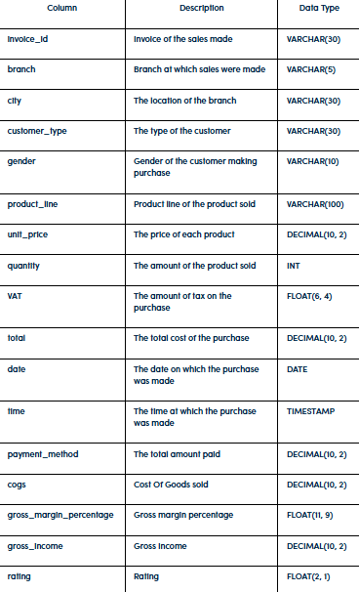

ABOUT DATA
This dataset contains sales transactions from three different branches of Amazon, respectively located in Mandalay, Yangon and Naypyitaw. The data contains 17 columns and 1000 rows:

Slide 4

Approach used
DATA WRANGLING
FEATURE ENGINEERING
EXPLORATORY DATA ANALYSIS (EDA)

Slide 5
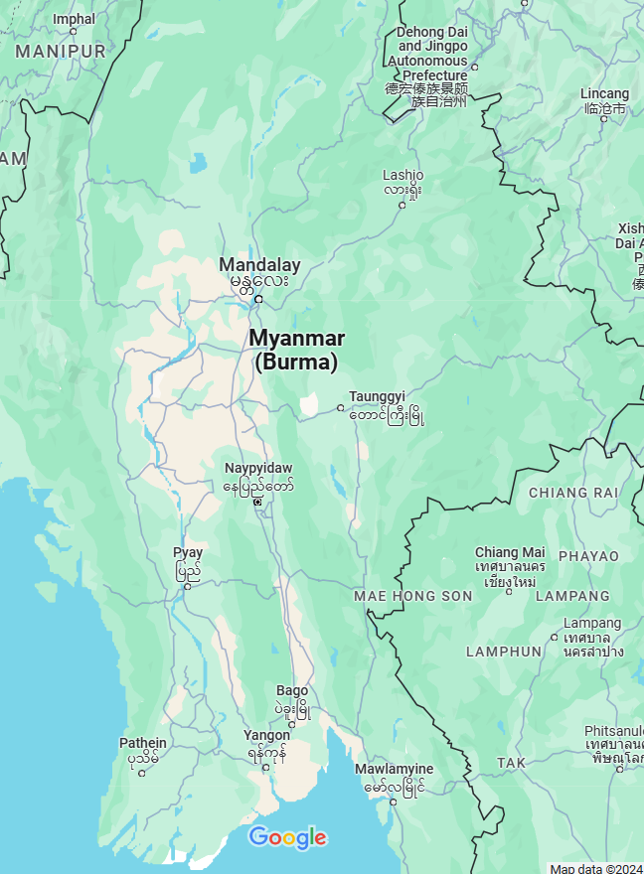
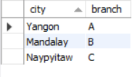
CITIES AND BRANCHES

Slide 6
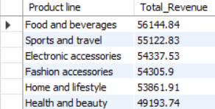
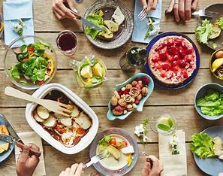
PRODUCT ANALYSIS
Highest Revenue

Slide 7
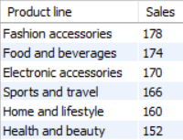

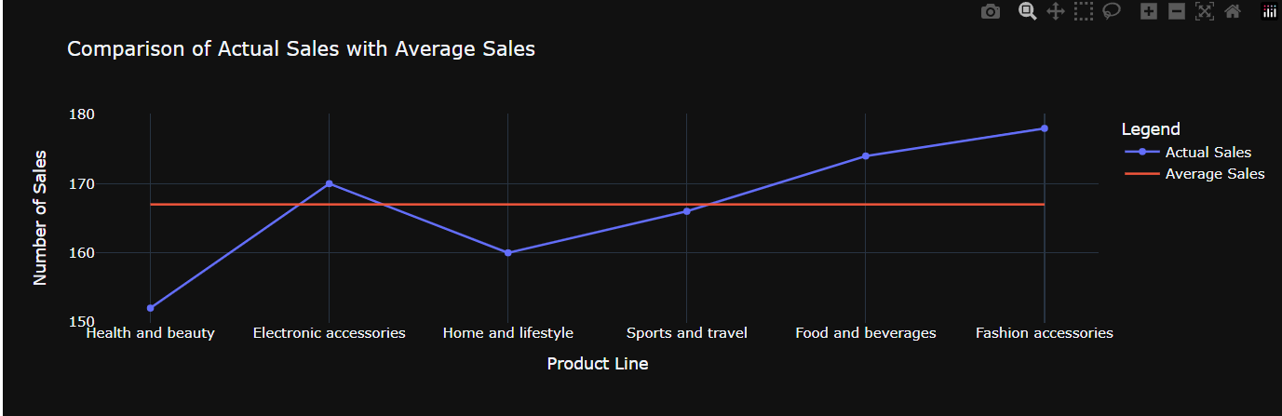
Comparision of Sales by Product line

Slide 8
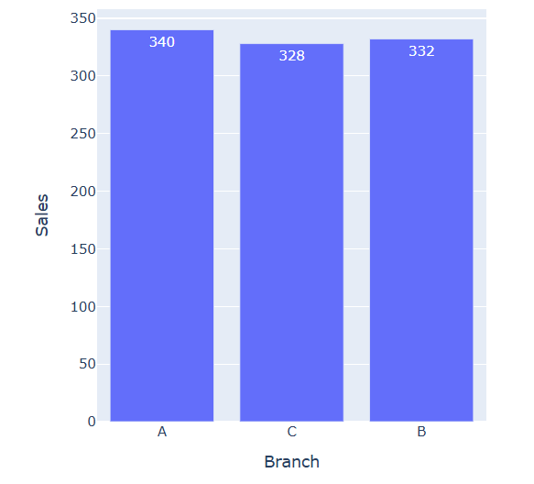
SALES ANALYSIS
Branch Performance in Sales
Branch A has achieved the highest sales among all branches

Slide 9
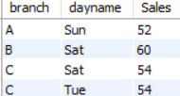
Sales-High Sales day for each branch
Branch A-Sunday
Branch B-Saturday
Branch C - Saturday & Tuesday

Slide 10
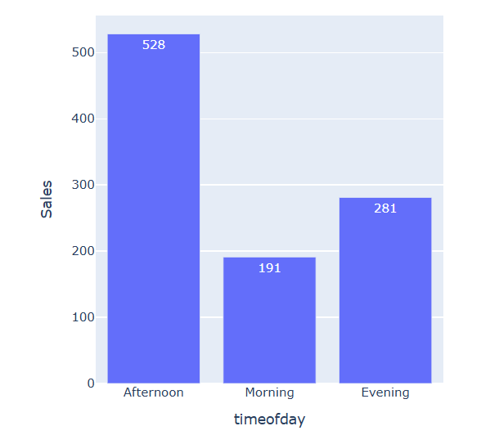
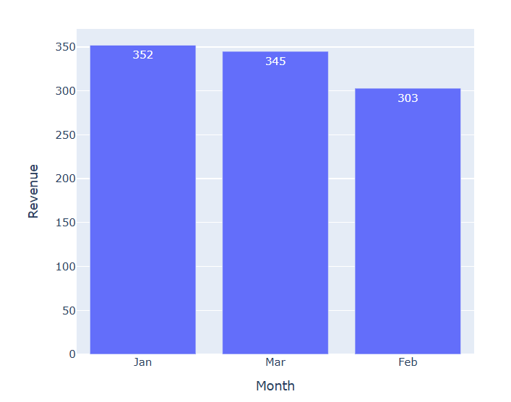
Sales-Time of day
Sales-by Month
Afternoon
January

Slide 11
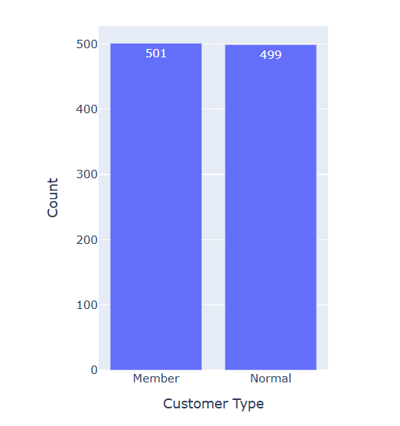
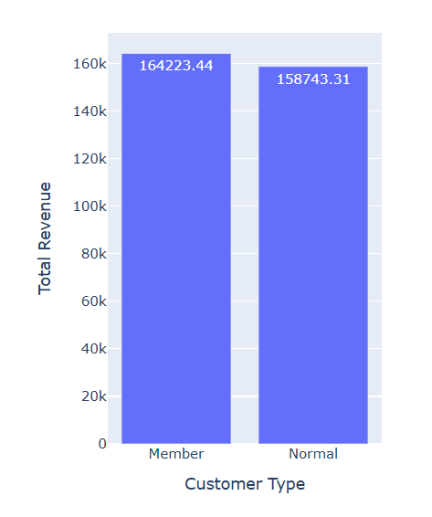
CUSTOMER ANALYSIS
Customer types
Customer type contributing the highest revenue
Member

Slide 12
CUSTOMER ANALYSIS
Customer types
Customer type contributing the highest revenue
Member

Slide 13
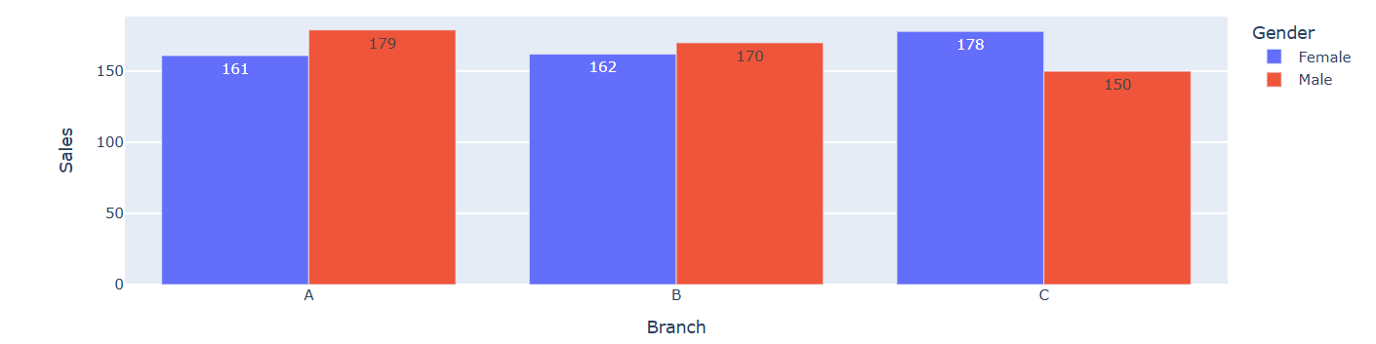
Distribution of Gender for each branch
1.Female
2.Male

Slide 14
CONCLUSION
Factors effecting sales
Branch performance
2. High VAT
3. Temporal Patterns
4. Product line
Recommendations
Targeted Promotions and Discounts during low-traffic periods
2. Dynamic Pricing
3. Loyalty Programs

Slide 15

THANK YOU

